Slide 1
Linux Device Model

Slide 2
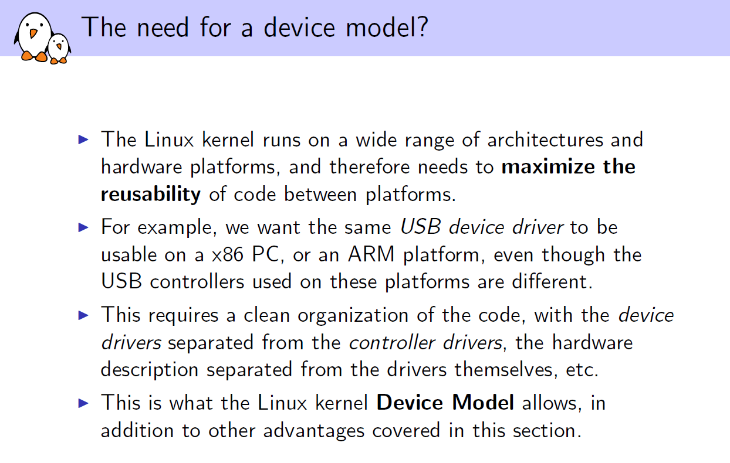

Slide 3
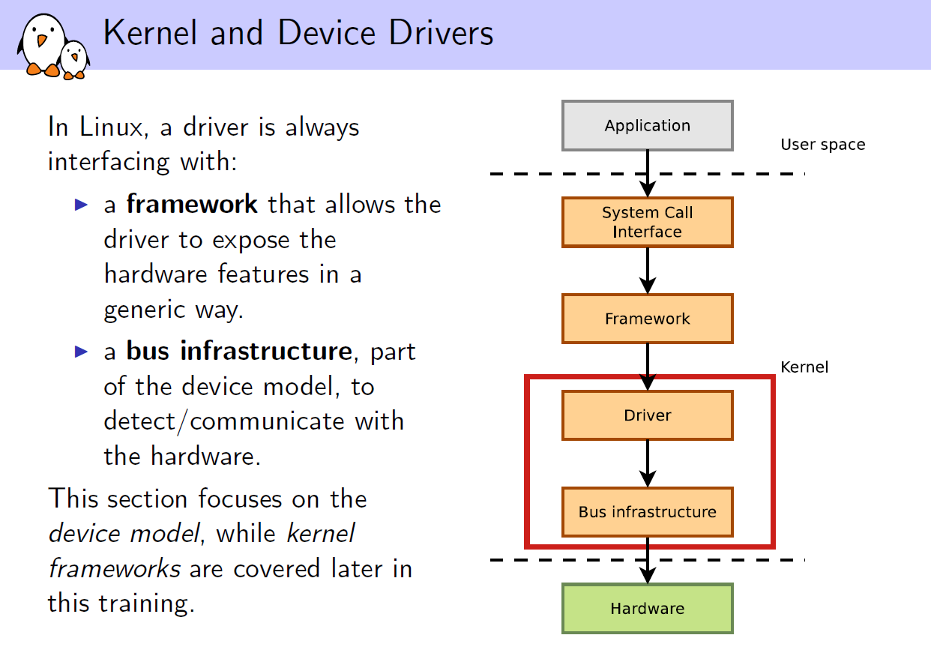

Slide 4
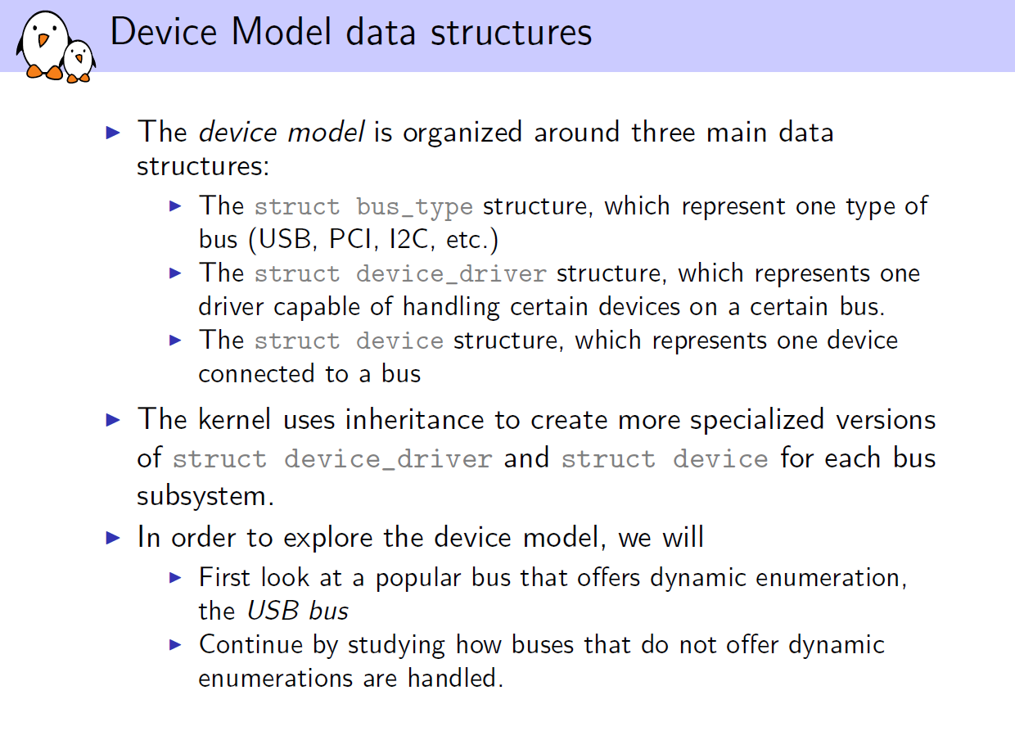

Slide 5
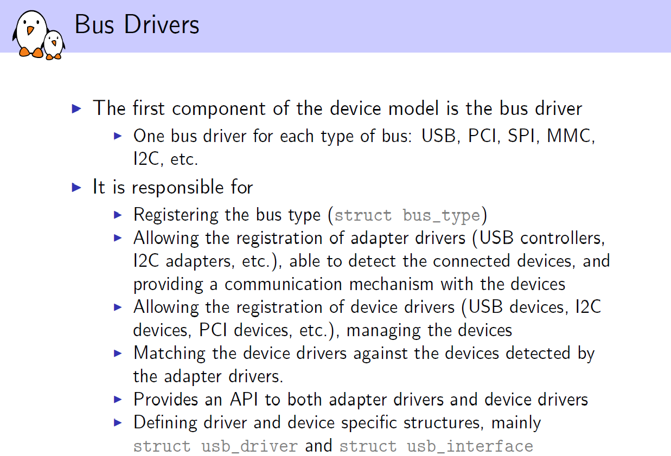

Slide 6
Sysfs
The kernel provides a representation of its model in userspace through the sysfs virtual file system. It is usually mounted in the /sys directory and contains the following subdirectories:
block - all block devices available in the system (disks, partitions)
bus - types of bus to which physical devices are connected (pci, ide, usb)
class - drivers classes that are available in the system (net, sound, usb)
devices - the hierarchical structure of devices connected to the system
firmware - information from system firmware (ACPI)
fs - information about mounted file systems
kernel - kernel status information (logged-in users, hotplug)
module - the list of modules currently loaded
power - information related to the power management subsystem
The sysfs information is found in files that contain an attribute. Some standard attributes (represented by files or directories with the same name) are as follows:
dev - Major and minor device identifier. It can be used to automatically create entries in the /dev directory
device - a symbolic link to the directory containing devices; It can be used to discover the hardware devices that provide a particular service (for example, the ethi PCI card)
driver - a symbolic link to the driver directory (located in /sys/bus/*/drivers )

Slide 7
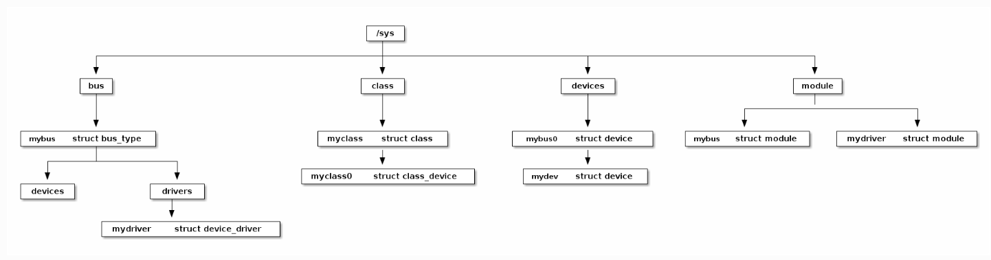
Linux Device Model provides a number of structures to ensure the interaction between a hardware device and a device driver. The whole model is based on kobject structure. Hierarchies are built using this structure and the following structures are implemented:
struct bus_type
struct device
struct device_driver

